Slide 1
Demo 1
Toni Pikkarainen

Slide 2
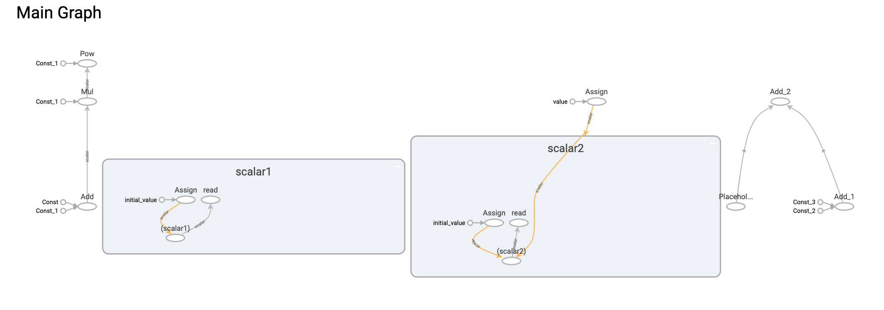
Task 1-1
Graph with tensorboard (problem with downloading image.html):

Slide 3
Task 1-2
Training dataset: https://people.sc.fsu.edu/~jburkardt/datasets/regression/x03.txt

Slide 4
Simple linear regression:
Model parameters :W = 2, b = 0, learning rate = 0.00001, iterations = 100000
Trained model:
W: [0.9758865] b: [98.4632] loss: 8393.635
Predicted values:
Model parameters :W = 2, b = 0, learning rate = 0.00001, iterations = 1000
Trained model:
W: [2.824746] b: [5.759417] loss: 34292.85
Predicted values:
Age | Blood pressure
20 | 117.98
25 | 122.86037
54 | 151.161
88 | 184.34
Age | Blood pressure
20 | 62.25
25 | 76.37
54 | 158.29
88 | 254.33

Slide 5
Predicted values seem like more sensible with more iterations which makes sense
I could have guessed the b parameter better so model would have worked better with smaller number of iterations also

Slide 6
Linear regression with estimator:
I split the set half for training and evaluation.
For 1000 steps and 1000 number of epochs :
train metrics: {'average_loss': 800.93365, 'label/mean': 149.8, 'loss': 12014.005, 'prediction/mean': 146.41618, 'global_step': 1000}
eval metrics: {'average_loss': 1609.6028, 'label/mean': 135.26666, 'loss': 24144.043, 'prediction/mean': 110.033295, 'global_step': 1000}
Predictions:
Age | Blood pressure
20 | 58,95
25 | 72,73
54 | 152,66
88 | 246,37

Slide 7
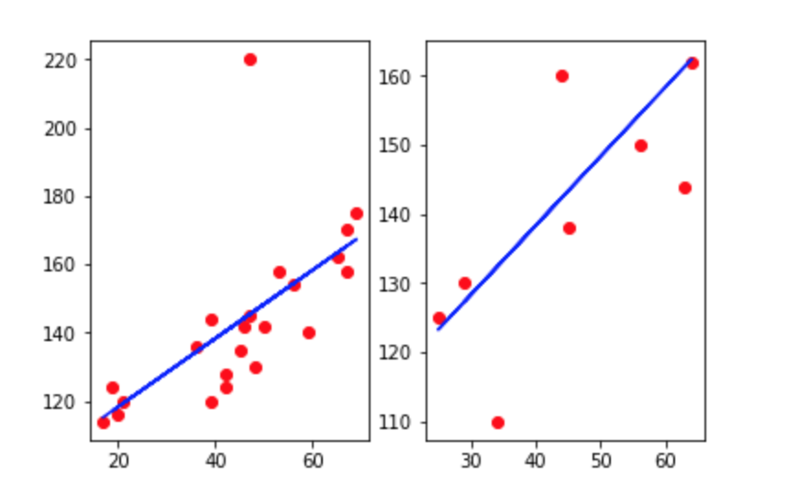
Linear regression with scikit-learn
Train and test visualizations.

